Slide 1
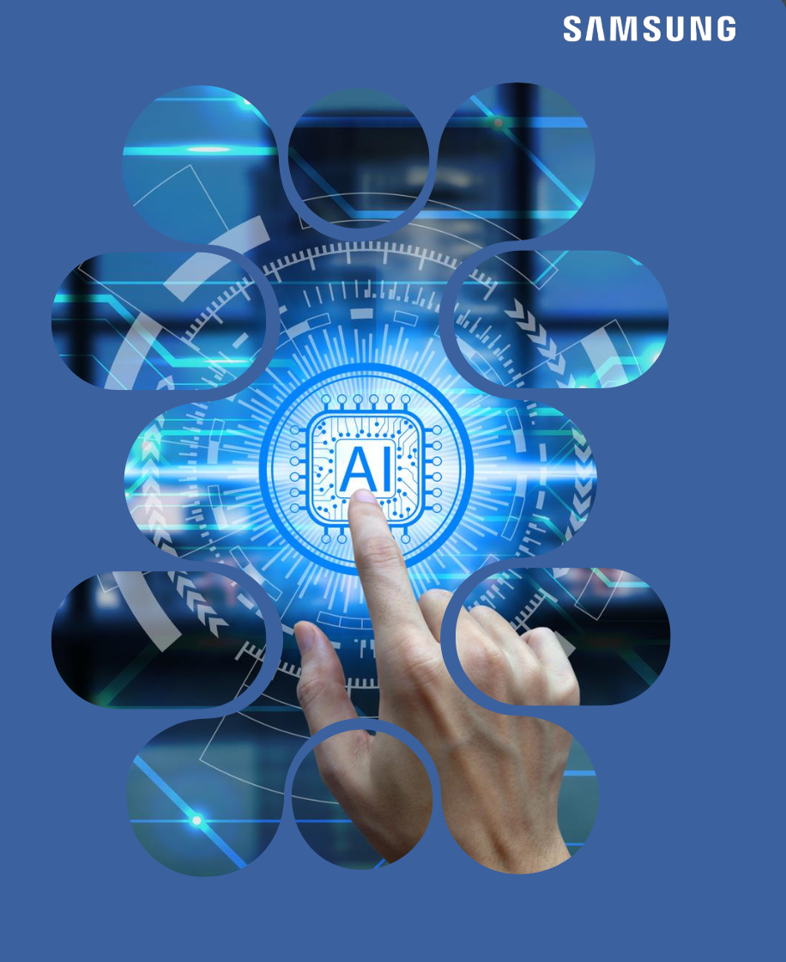
Home AI AND SMART AUTOMATION
GEN AI HACKATHON PHASE- 2
TEAM : MS51
NAME : MOHAMMED SAHIL T S

Slide 2
Introduction to Home ai & Smart Automation
What is home AI and Smart automation ?
In simple terms Home AI and Smart Automation involve using artificial intelligence and connected devices to manage home functions automatically.
Ex: Smart thermostats, voice assistants, lighting control, energy optimization, predictive maintenance
Home AI + Smart Automation = A smart home that’s convenient, efficient, and responsive to your needs

Slide 3
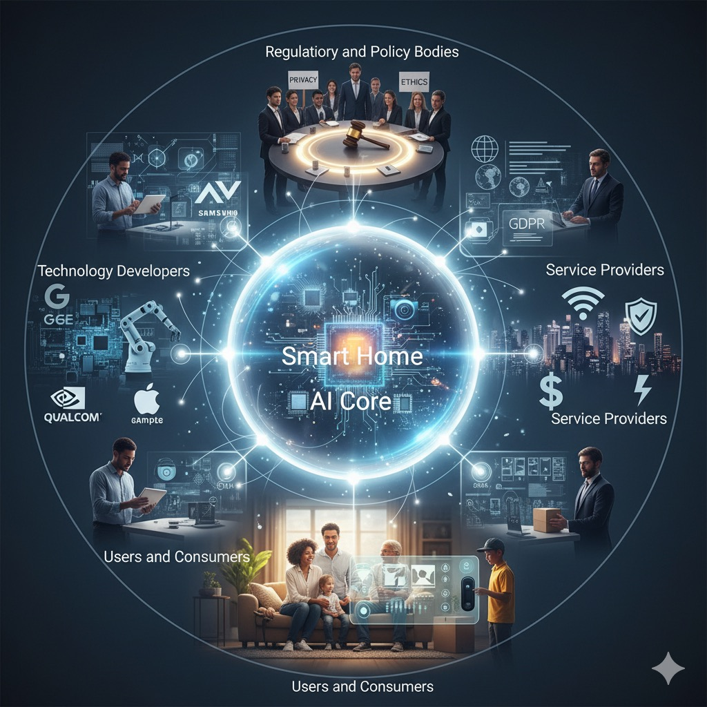
Who are Stakeholders ?
Stakeholders are individuals, groups, or organizations that have an interest
in or are affected by the actions, decisions, or outcomes of a project, business,
or organization.
Also , Stakeholders are the people or groups who are involved in, affected by, or have an interest in the smart home system.

Slide 4
Stakeholders in Home Ai system
Homeowners
They are the main users of the system. They control how it#39;s used and benefit from the comfort, security, and energy savings it provides.
Device Manufacturers
These are the companies that create smart devices like motion sensors, smart lights, thermostats, and cameras .
Smart Home Service Providers
Companies like Amazon (Alexa), Google (Google Home), or Apple (HomeKit) offer platforms that connect and control smart devices. They also provide updates and cloud services.
Data Security and Privacy Experts
They make sure your personal data is protected and that the system follows privacy rules. This is important because smart homes collect a lot of information.
Internet and Cloud Providers
They supply the internet connection and cloud storage needed for remote control, voice assistants, and AI features.
Utility Companies (optional)
Some homes connect their smart systems to utility companies for things like smart meters or energy-saving programs.

Slide 5
Needs of stakeholders in business , consumers and teams.
🔘Businesses
Profitability & ROI: Develop AI products that are cost-effective
Market Differentiation: Innovative features that set their products apart from competitors.
Scalability: Ability to scale production and updates efficiently.
Data Privacy & Security: Protect user data to maintain trust
🔘Consumers
Ease of Use: Intuitive, user-friendly interfaces that require little technical know-how.
Convenience: Automate routine tasks seamlessly .
Privacy: Strong safeguards on personal data and control over data sharing.
Affordability: Reasonable upfront and maintenance costs.
🔘Teams
Clear Communication: Well-defined goals
Training & Knowledge: Up-to-date skills on AI, smart home tech & customer engagement.
Collaboration Tools: Platforms to share ideas, track progress, and solve problems efficiently
Agility: Ability to adapt quickly to market trends .
Support Infrastructure: Tools and resources to help sales .

Slide 6
Real-World Challenges & Innovative Responses
🔘Challenge:Privacy and Data Security
Smart devices collect personal data (location, habits, voice, etc.). This raises concerns about hacking or data misuse.
🔘Innovative Response:
- End-to-end encryption to protect data.
- Local processing to reduce cloud storage.
- User data controls so people can choose what gets shared
🔘Challenge:Compatibility Issues
Different devices from different brands often don’t work well together.
Innovative Response:
- Development of universal platforms
- Voice assistants (like Alexa, Google Assistant) acting as central hubs for multiple devices.
🔘Challenge: Power Consumption
Smart devices may add to energy use, which defeats their purpose.
Innovative Response:
- AI that learns habits and optimizes energy usage.
- Devices with low-power modes and automatic shutdown when not in use.
.

Slide 7
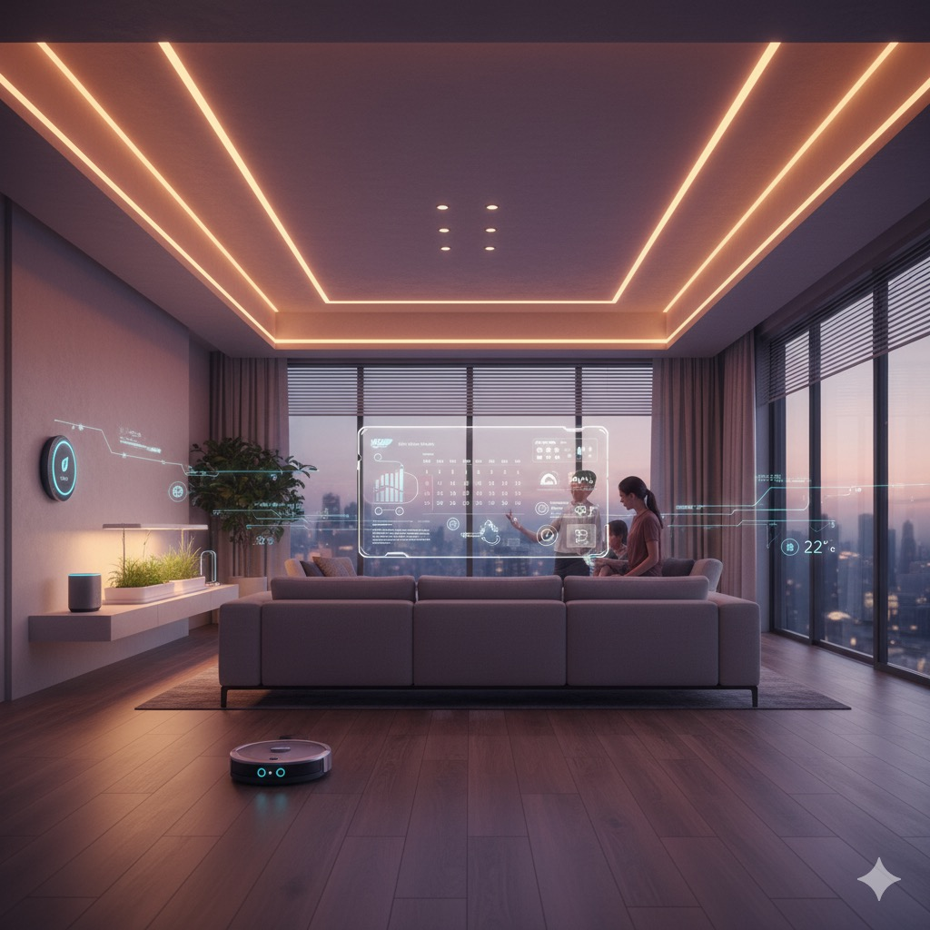
Action Steps Toward : Smart Home AI
🔘Choose a Smart Home Platform :- Pick a system that suits you: Amazon Alexa, Google .
- Make sure devices you buy are compatible with your chosen platform
🔘Install and Connect Devices :- Follow setup guides to connect devices to your Wi-Fi / smart hub.
- Test basic functions and automation
🔘Focus on Security and Privacy :- Secure your Wi-Fi network with a strong password.
- Review privacy settings on apps and devices
🔘Stay Updated :- Keep device firmware apps updated for security and new features.
- Explore new smart home products and trends to improve your setup.
🔘Add AI Features : - Integrate voice assistants for hands-free control.
- Use AI-enabled devices like smart thermostats that learn your schedule.

Slide 8
Goals and outcomes to
measure.
🔘Increase Home Comfort- User satisfaction surveys (are people happier with temperature, lighting )
- Number of automation routines used daily
- Reduction in manual adjustments.
🔘 Improve Energy Efficiency- Reduction in monthly energy bills
- Percentage of energy saved compared to before automation
- Usage data from smart thermostats, lights, and appliance
🔘Ensure Data Privacy and Security- Number of security breaches or vulnerabilities reported
- User trust ratings regarding privacy
- Compliance with data protection regulations
🔘Enhance Home Security- Number of security incidents detected/prevented
- Response time to alerts (speed of notification)
- User confidence in security features .

Slide 9

Code Overview
The code focuses on users choice on adjusting and on/off system
Also the code shows the status of the sensors.
The code is written in Java
The code consists of two sensors :
-> Two lights turning on/off based on sensors,
->Temperature adjustment based on a sensor.

Slide 10
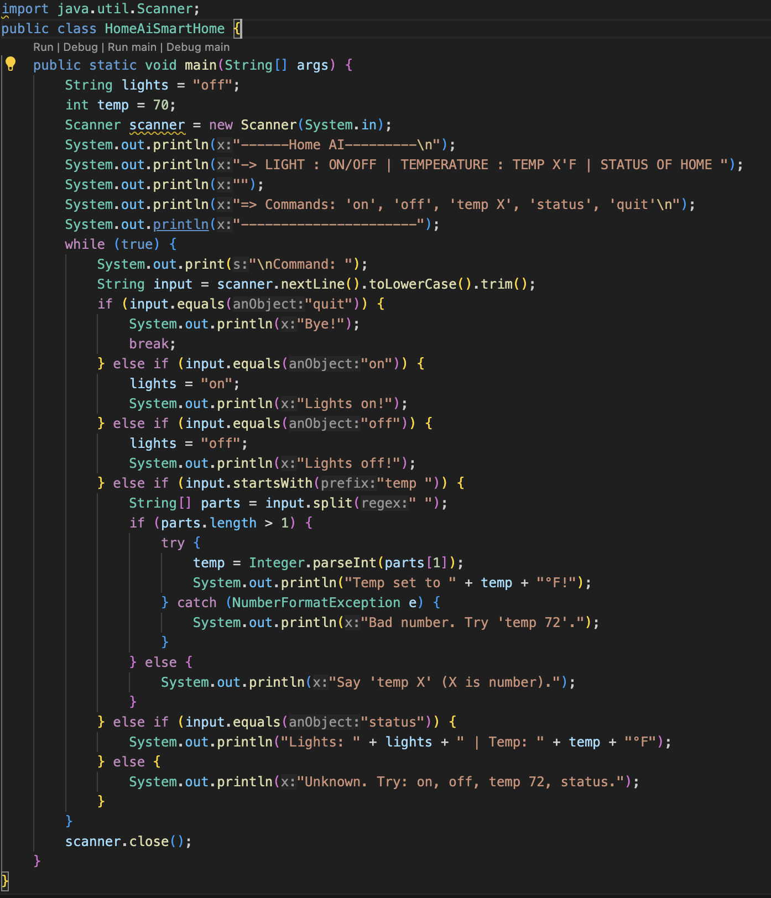
Programming Language used : Java
IDE: VSCode
Library Used: java.util.Scanner for user input
Variables to store state (lights, temp)
Conditionals (if-else if) for command logic
Loops (while) to keep the app running
String parsing to read and interpret user input
Exception Handling to manage bad inputs
User interaction using Scanner
Conditional Statements:
if (input.equals("on")) – Turns lights on
else if (input.equals("off")) – Turns lights off
else if (input.startsWith("temp ")) – Sets temperature
else if (input.equals("status")) – Displays current status
else – Handles unknown commands YOU CAN ACCESS THE FULL WORKING CODE
IN THE ANOTHER FILE ,named as:HomeAiSmartHome.java

Slide 11
CONCLUSION
Home AI & Smart Automation are not just futuristic ideas — they’re shaping how we live today.
With increased efficiency, safety, and comfort, smart homes represent a major step toward a more connected and intelligent lifestyle .
Smart homes are not just about technology — they’re about improving the way we live.
Technology makes our lives easier. AI makes our homes smarter.
Thank You
For taking your time and interest in my presentation on Home AI and Smart Automation.

